Slide 1


“Hotel Management System —
System Presentation”
NAME: Leif Anthony Villaraza
SECTION&YR: BSIT- 2D

Slide 2

INTRODUCTION & RATIONALE
The Hotel Management System is designed to simplify and automate hotel operations such as room management and customer check-in. The system helps staff manage guest information, room availability, and records efficiently. This project aims to improve accuracy, reduce manual work, and enhance the overall management process of hotel services.

Slide 3
PURPOSE & BENEFICIARIES
The purpose of this system is to provide an organized and efficient way to manage hotel operations digitally. It helps store and retrieve guest and room information quickly.
Beneficiaries:
Hotel administrators
Hotel staff
Hotel management
Customers/guests

Slide 4
Stakeholders / System Users
Users:
Admin – manages rooms, customer check-ins, and system data.
Stakeholders:
Hotel owner/management
Hotel staff
Customers/guests who use hotel services

Slide 5
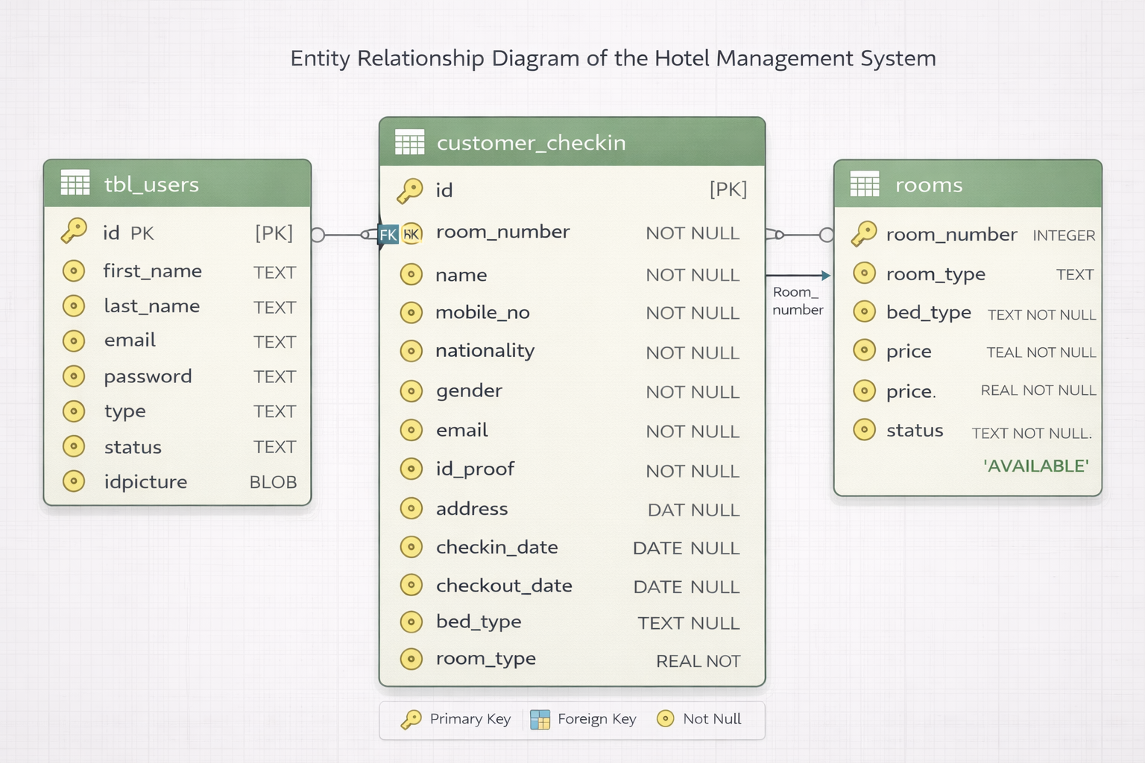
ERD (Entity Relationship Diagram)
This is the Entity Relationship Diagram (ERD) of the Hotel Management System. It consists of three tables: tbl_users, rooms, and customer_checkin. The rooms table stores room details, while the customer_checkin table records guest check-in information. These two tables are related through room_number, where one room can have multiple check-in records. The tbl_users table stores the system users who manage the system.

Slide 6
F
Flowchart
This is the flowchart of the system. The process starts at the Landing Page, where the user can register or log in. If the user registers, their account information is stored in the database before proceeding to the login page. After logging in, the system verifies the credentials and determines the account type. If the user is an Admin, the system opens the Admin Dashboard where the admin can manage users, rooms, and customer bills. If the user is a User, the system opens the User Dashboard where the user can update their profile, book rooms, and manage bookings. All actions interact with the database and the user can log out to end the session.

Slide 7
LIVE APPLICATION DEMO

Slide 8
CONCLUSION
The Hotel Management System provides an efficient solution for managing hotel operations. It helps improve data organization, reduces manual errors, and allows faster processing of guest and room information.

